Slide 1
Conjugation

Slide 2
Conjugation
Conjugation is the transfer of genetic material between donor bacteria to recipient bacteria through direct cell to cell contact, or through a bridge-like connection between the two cells.
Conjugation experiment performed by Joshua Lederberg and Edward Tatum in 1946.

Slide 3
Conjugation
Donor bacteria posses fertility plasmids or sex plasmids that are self transmissible.
They exist both gram positive and gram negative bacteria.
F-plasmid are transferred with strains of same species.
A recipient cell that has received DNA as a result of conjugation is called transconjugant.

Slide 4
Promiscuous plasmid
Generally plasmid transfer is intraspecific; but many plasmid transfer DNA between unrelated species called promiscuous plasmids.
F+ − F- Conjugation
Hfr − F- Conjugation
F’ − F- Conjugation

Slide 5
F+ − F- Conjugation
F-plasmid (f-factor) in E.coli (gram –ve bacteria).
E.coli strains with extrachromosomal F plasmid are called F+ and act as donor.
Strains that lack F plasmid are F- act as rercipient.
F plasmid consist of 25 transfer genes(tra): that function for- expression of sex pili,
- synthesis & transfer of DNA
- interference with the ability of F+ bacteria serves as recipient.
Type IV secretion system(T4SS) which act as a channel through which proteins or protein DNA complexes can be translocated.

Slide 6
(tra) genes
(Mpf) (Dtr)
Mating pair formation gene DNA transfer gene (plasmid)

Slide 7
Steps of conjugation
Sex pilus is used to establish contact between the F+ and F- cells.
The F+ cell prepare for DNA transfer by assembling a T4SS.
Dtr genes encode proteins that bind to the plasmid DNA at the origin of transfer, oriT, forming a complex called relaxosome.
Key catalytic component of the relaxosome is the enzyme relaxase.
This enzyme produces a nick with in the oriT and becomes transiently attached to the 5’end of the ssDNA .
One strand of the plasmid DNA in the 5’ to 3’ direction from donor to recipient .

Slide 8
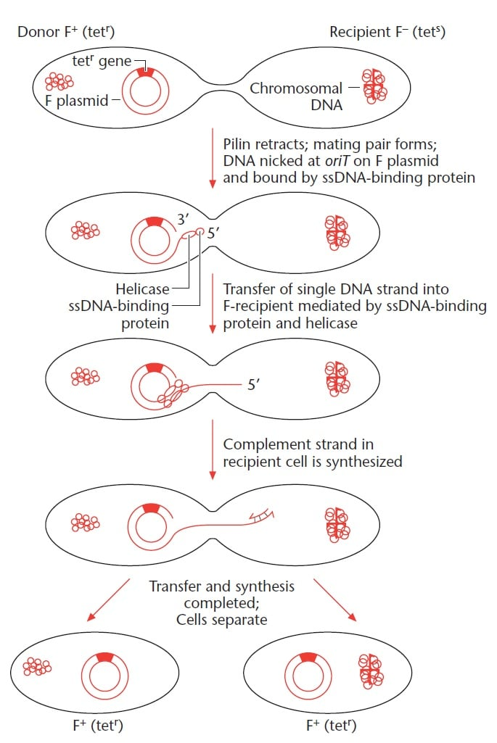

Slide 9
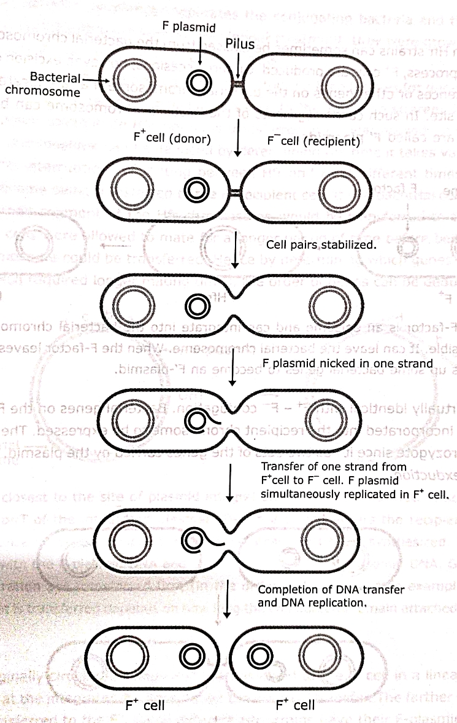
F+ − F- Conjugation

Slide 10
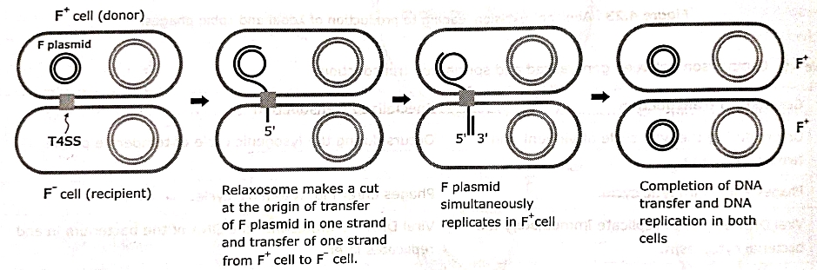

Slide 11
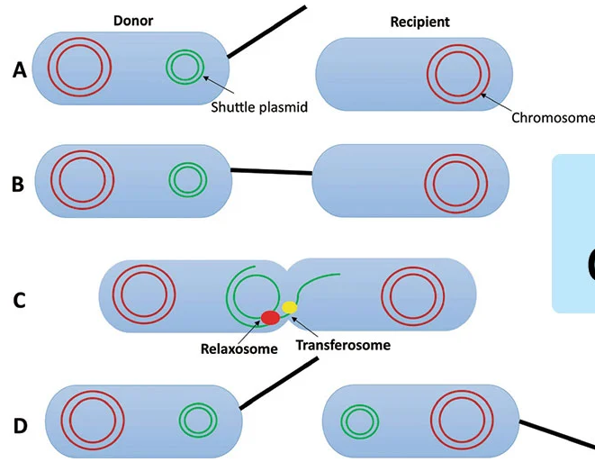

Slide 12
Hfr − F- Conjugation
Hfr (High frequency recobination) cell.
F plasmid integrated with bacterial chromosome.
donor strains with integrated F plasmid can transfer chromosomal genes to recipients with high efficiency.

Slide 13
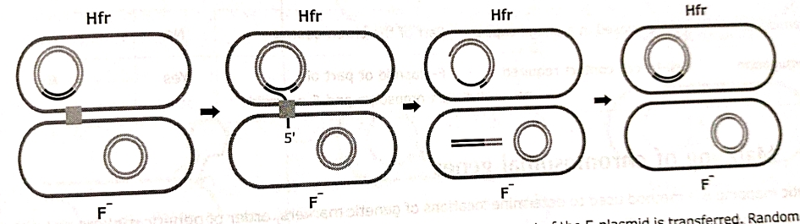

Slide 14
F’ − F- Conjugation
F’ Plasmid: Integrated F- plasmid in Hfr strains can sometimes excised from bacterial chromosome.
In rare case excision occurs by recombination involving insertion sequence or other genes on bacterial chromosome to become integrated into hybrid F plasmid.
Due to error in excision of F plasmid from Hfr the chromosomal gene of donor is picked up.

Slide 15
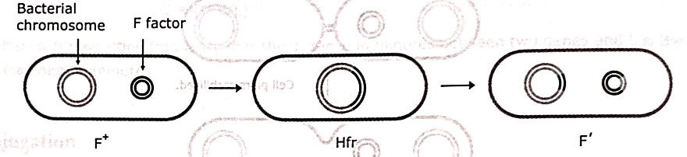

Slide 16
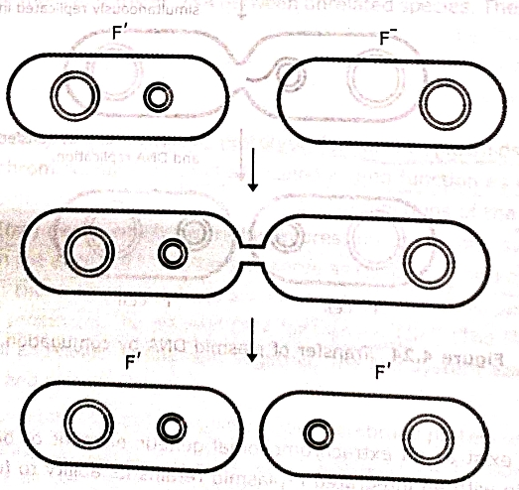

Slide 17
Examples of bacterial conjugation
Agrobacterium tumefaciens causes crown gall tumor in plants by transferring the T DNA element, a part of the Ti (tumor-inducing) plasmid present in this bacterium, into a plant cell where the T element becomes incorporated into the plant cell’s genome.
Conjugative plasmids encoding antimicrobial resistance genes are called R plasmids which are transferred through Shigella spp that might result in a widespread outbreak of antibiotic-resistant Shigella-mediated dysentery.

