Slide 1
Transduction

Slide 2
Transduction
Discovered by Lederberg and Zinder in 1951in Salmonella typhimurium.
In transduction, bacteriophages function as vector to transfer DNA from donor bacteria into recipient bacteria.
Two kinds of Transduction
1. Generalized Transduction
2. Specialized Transduction

Slide 3
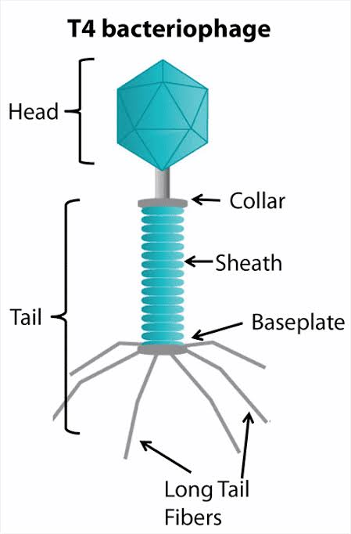
Bacteriophage : virus that infects and replicate with in a bacterium.
Bacteriophage- 1. Temperate
2. Virulent

Slide 4
Bacteriophage: virus that infects and replicate with in a bacterium.
Virulent Phage: Follow Lyctic cycle. Capable of causing bacterial infection and eventually destruction and death of bacterial cell.
eg. T4 phage
2. Temperate Phage: Phage DNA incorporated into bacterial DNA and replicate Lysogenic and after some time become virulent cause lysis.

Slide 5
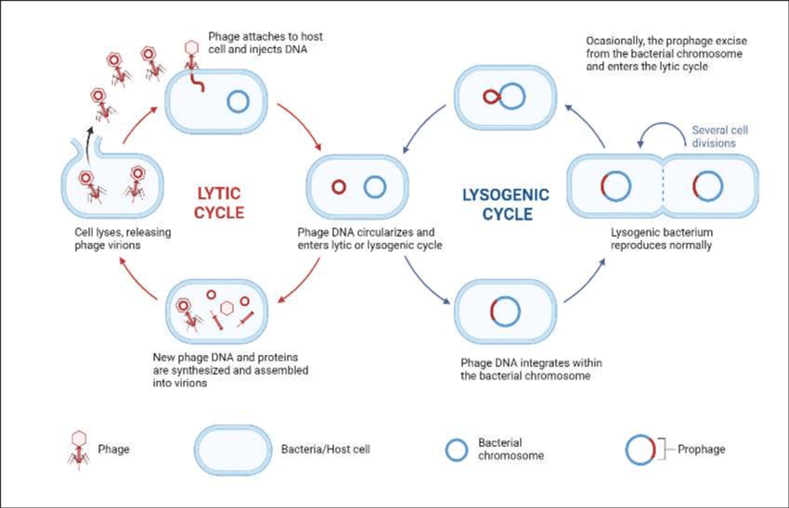

Slide 6
Generalized Transduction
In Generalized transduction a DNA fragment is transferred from one bacterium to another by a lytic phage which carry donor bacterial DNA due to an error.

Slide 7
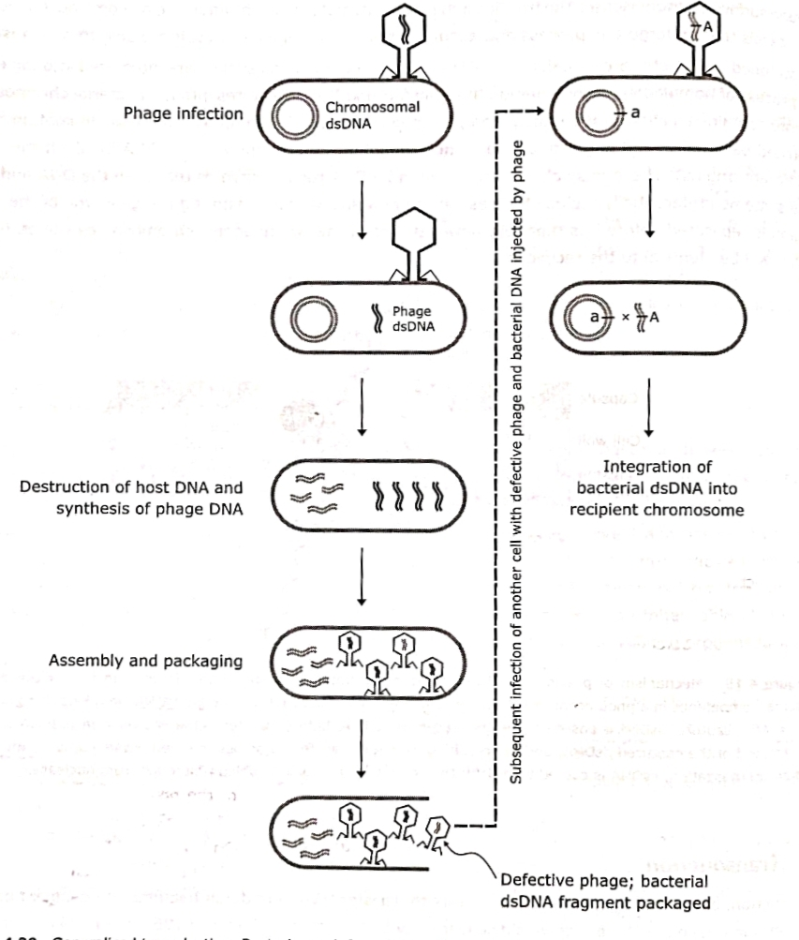

Slide 8
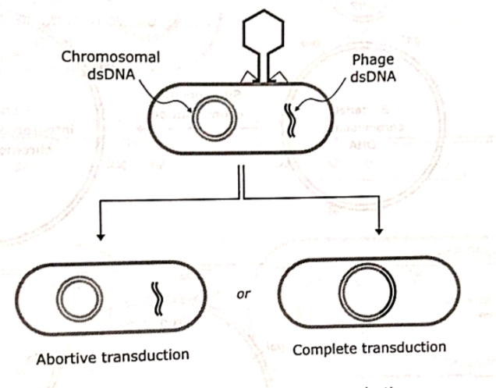
Generalized Transduction may be abortive or complete.

Slide 9
Complete Transduction
The DNA remains double-stranded during transfer and both strands are integrated into the endogenote.
Frequency of Abortive transduction is greater than complete transduction.

Slide 10
Abortive transduction
The donor DNA fragment (exogenote) does not integrate with (endogenote) and also not replicate.
Only one bacterium contain exogenote and other bacterium is like parent among the progeny.

Slide 11
Specialized Transduction
A DNA fragment is transferred from one bacterium to another by a temperate bacteriophage (Lysogenic) which carry donor DNA along with phage genome due to an error.
In specialized transduction phage insert in genome at donor at specific site and perform site specific recombination.

Slide 12
Specialized transducing phage are formed only when lysogenic donor bacteria enter the lytic cycle and release phage progeny.

Slide 13
The only bacterial genes that can be transduced are those very near the site at which the prophage is integrated.
eg: The only site at which lambda (λ) phage integrates into the host chromosome is between the genes for galactose fermentation(gal) and biotin synthesis(bio).
So, if the prophage disintegrates abnormally from the host chromosome, only the gal or bio genes could be transduced.

Slide 14
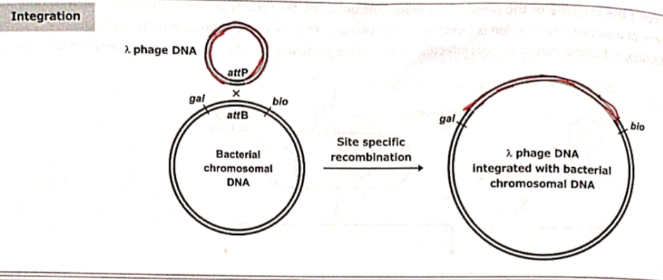

Slide 15
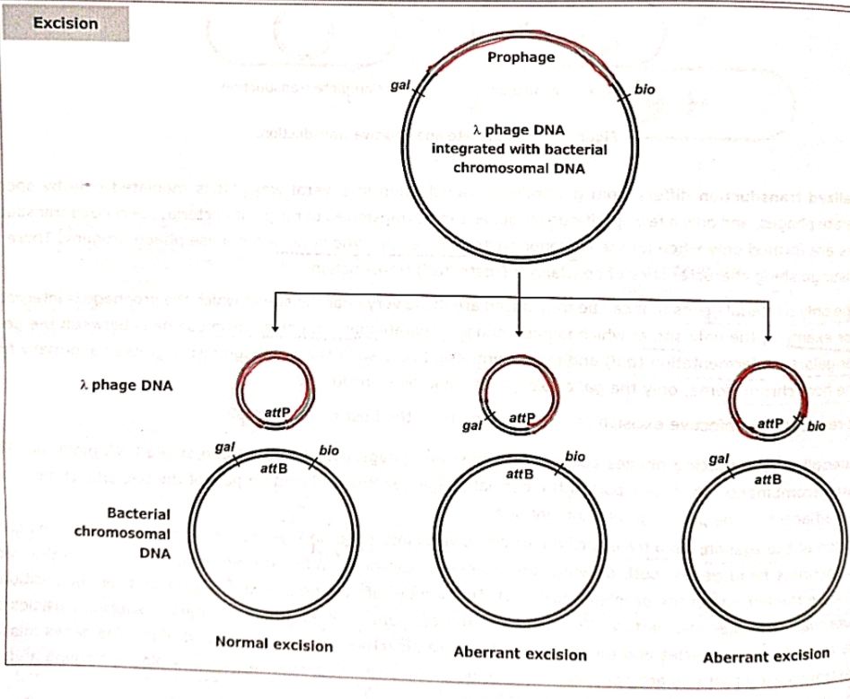

Slide 16
Aberrant excision leading to production of λdgal and λpbio phage.

Slide 17
