Slide 1
ARCHAEBACTERIA
By
Savita Chandrawanshi
Asstt. Professor, Department of Microbiology
Govt. Digvijay Autonomous PG College, Rajnandgaon.C.G.

Slide 2
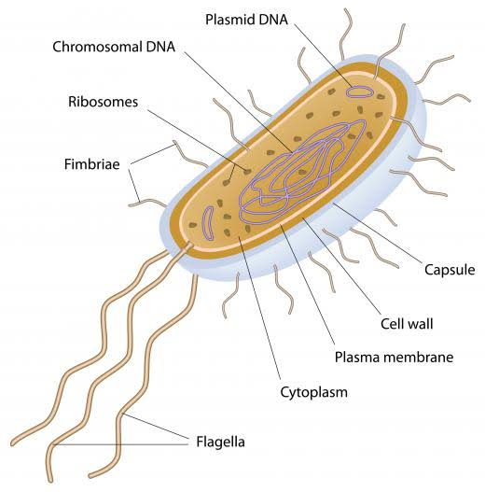

Slide 3
General Characters
Archaebacteria is a type of single celled prokaryotic organism.
They belong to kingdom of Archaea.
They are also known as most primitive organisms on the earth.
They can survive in extreme environment such as high salty, high temperature, and high acidic.

Slide 4
Archaebacteria can be gram positive or gram negative .
They are spherical, rod shaped, spiral and other.
They can be aerobic or anaerobic and facultative or obligate .
Very similar to eubacteria ( simply bacteria).

Slide 5
Cell wall
Some archaebacteria such as Thermoplasma species lack cell wall while most others do contain cell walls.
Many archaebacteria have cell walls made up of the polysaccharide pseudomurein.
Pseudomurein- modified peptidoglycan lacking D-amino acids and containing N-acetyl talosaminuronic acid(NAT) instead of N-acetylmuremic acid(NAM) and N-acetylglucasamine; found in methanogenic bacteria.

Slide 6
N-acetyltalosaminuronic acid(NAT) and N-acetylglucasamine (NAG) which are linked to each other by β(1-3) glycosidic bond.
All archaebacteria are resistant to lysozyme and beta-lactam antibiotics such as penicillin.

Slide 7
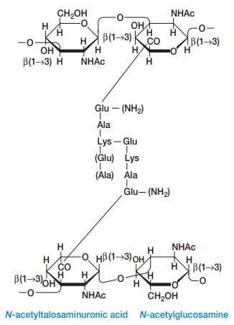

Slide 8
Plasma membrane
Plasma membrane of archaebacteria made up of ether linked (-O-C-) phospholipid, while bacteria and eukaryotes plasma membrane made up of ester(-O-)linked phospholipid.
Archaebacteria membrane lipids contain branched chain hydrocarbons attached to glycerol by ether links.

Slide 9
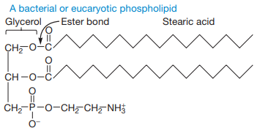
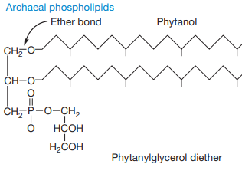

Slide 10
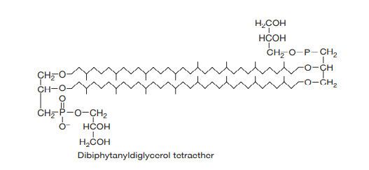

Slide 11
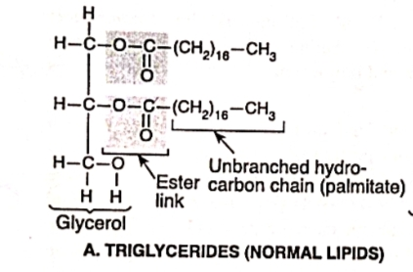
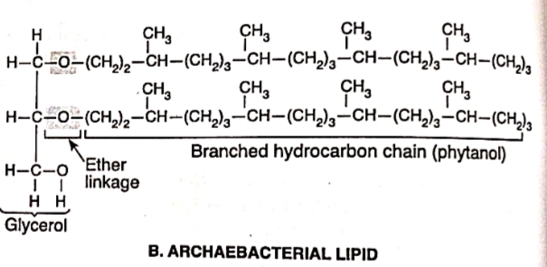

Slide 12
Major groups of archaebacteria
Methanogens
Halophiles
Thrmophiles

Slide 13
Methanogens
methane producing obligate anaerobes.
They are widely distributed in nature such as deep sea water, sewage area.
Methanogens obtain their energy from the use of carbon dioxide and hydrogen gas.
They comprise the largest group of archaebacteria.

Slide 14
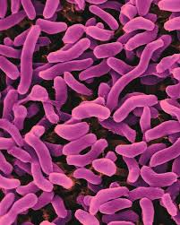
Halophiles
Halophiles are aerobic chemoorganoheterotophs.
They thrive in very high salt concentration.
Example: Halobacterium salinarium.
H. Salinarium can carry out photosynthesis without chlrophyll or bacteriochlorophyll by using bacteriorhodopsin.

Slide 15
Thermophiles
Thermophiles are heat-loving archaebacteria found near hydrothermal vents and hot springs.
Optimum growth temp. 70-110 ˚C.
They are gram negative and usually strict anaerobes.

Slide 16
